Slide 1
DL Lab Project
Avinesh Pambally (24P0620003)
Chaturthi Naik (24P0620004)

Slide 2
RAG-based Legal Document Chatbot

Slide 3
RAG-based Legal Document Chatbot
Legal documents are often overwhelming due to jargon, long sentences, and confusing formatting
A chatbot is being developed to help answer questions about legal papers
Example: If asked about a landlord not returning a security deposit, the chatbot will:
Find relevant deposit information.
Summarize deadlines, penalties, and next steps clearly.
Unlike basic chatbots, it focuses only on the specific document being questioned.
The tool aims to make legal documents more accessible and reduce stress for users.

Slide 4
Background
Language models can learn from vast amount of unstructured data and provide personalized, context-aware answers
This capability is driving shift from traditional search engines towards AI powered platforms for for general and enterprise use
Two main approaches:
Fine tuning
Retrieval-Augmented Generation

Slide 5
Background
Fine tuning: Training the model on specific data so the knowledge is embedded in the model weights. While this gives fast and precise results, it's complex and requires significant expertise and data preparation.
Retrieval-Augmented Generation: More common and flexible. Here, the LLM retrieves relevant information from an external database and incorporates it into its response, allowing for dynamic and up-to-date knowledge without retraining the model

Slide 6
Our Approach
The chatbot uses Retrieval-Augmented Generation (RAG), combining:
Semantic search to understand queries and find relevant document parts.
Advanced language models to explain sections in simple, everyday language

Slide 7
Our Approach
Why RAG?
Local RAG lets you process and query sensitive PDF documents on your own machine, ensuring privacy and avoiding cloud dependencies
It leverages open-source tools and local LLMs, making it cost-effective and customizable

Slide 8
Tools - Technologies
Component | Technology
Orchestration | LangChain
Embedding & LLM | Ollama (nomic-embed-text & gemma3:4b)
Vector Store | Chroma
Text Extraction | UnstructuredPDFLoader
Chunking | RecursiveCharacterTextSpillter
UI Interface | Gradio
Language | Python

Slide 9
Tools - Technologies
LangChain: Python framework designed to build applications that combine large language models (LLMs) with external data sources. It simplifies the process of creating RAG pipelines by providing abstractions for document loading, splitting, embedding, storage, retrieval, and orchestration of queries and responses.
Ollama: Ollama is a tool for running large language models locally on your machine. The gemma3:4b is a specific 4-billion parameter model you can run with Ollama. In a RAG setup, Ollama serves as the LLM that generates answers based on both the user’s question and the retrieved context from your documents.

Slide 10
Tools - Technologies
Chroma: Chroma is an open-source vector database optimized for storing and searching embeddings (vector representations of text). In RAG, Chroma stores the vectorized chunks of your documents and quickly retrieves the most relevant ones when a user asks a question.
UnstructuredPDFLoader: This is a document loader (often used with LangChain) that extracts text from PDF files, handling complex layouts and structures. It’s the first step in ingesting your data, turning raw PDFs into text documents that can be further processed.

Slide 11
Tools - Technologies
RecursiveCharacterTextSplitter: A text splitter utility (from LangChain) that breaks large text documents into smaller, manageable chunks. Recursive splitting ensures chunks are of optimal size for embedding and LLM context windows, improving retrieval accuracy and model performance.
Gradio: Gradio is a Python library for building interactive web interfaces for machine learning models. In this context, it’s used to create a simple chat UI where users can upload PDFs and interactively ask questions, seeing responses generated by the RAG pipeline.

Slide 12
WorkFlow
PDF Ingestion : Use UnstructuredPDFLoader to extract text from PDFs
Chunking : Apply RecursiveCharacterTextSplitter to break the text into chunks
Embedding & Storage : Convert chunks into embeddings (vectors) and store them in Chroma
User Query : User asks a question via a Gradio web interface
Retrieval : The system retrieves the most relevant chunks from Chroma based on the query
Generation : Ollama (running gemma3:4b) receives the query and retrieved context, generating a precise, context-aware answer
Interface : The answer is displayed to the user in the Gradio interface

Slide 13
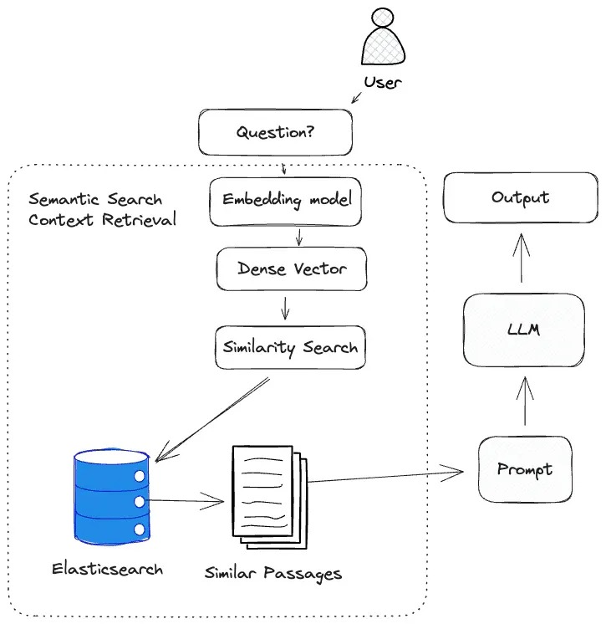
System Architecture

Slide 14
Results and Observations
The chatbot accurately retrieves and summarizes legal content when asked case-specific questions.
The use of multi-query reformulation improves the diversity and relevance of retrieved content.
Running the gemma3:4b model locally through Ollama offers privacy and reduces dependency on cloud APIs.
The Gradio UI provides an accessible way for users to interact with the chatbot.
All answers are grounded strictly in the input document, ensuring trustworthy results.

Slide 15
Demo

